Slide 1


ABBOTTABAD UNIVERSITY OF SCIENCE AND TEC TECHNOLOGY
PROJCECT GUESSING GAME
NAME KALEEMULLAH
DEPARTMENT COMPUTER SCIENCE
SEMESTER SECOND
ROLLNO F24-614
PROGRAM SOFTWARE ENGINEERING
PROJECT GUESSING GAME& PRSENTATION
SUBMITTED TO SIR JAMAL ABDUL AHAD
SUBMITTED BY KALEEM ULLAH

Slide 2
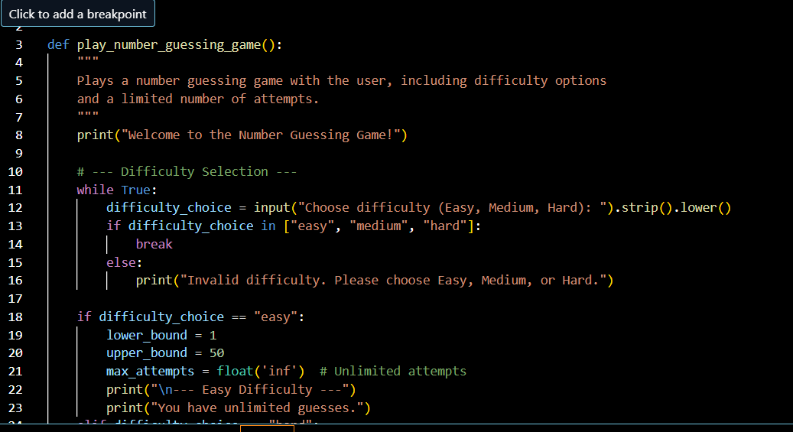

Slide 3
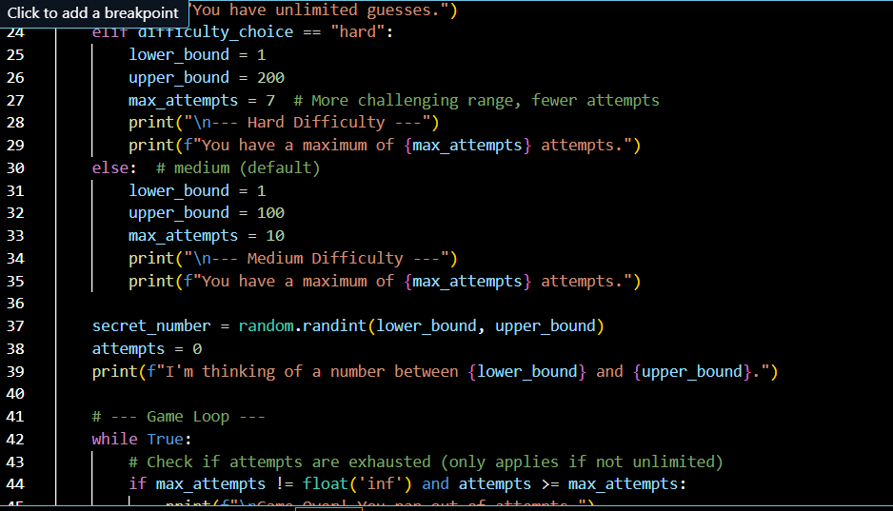

Slide 4
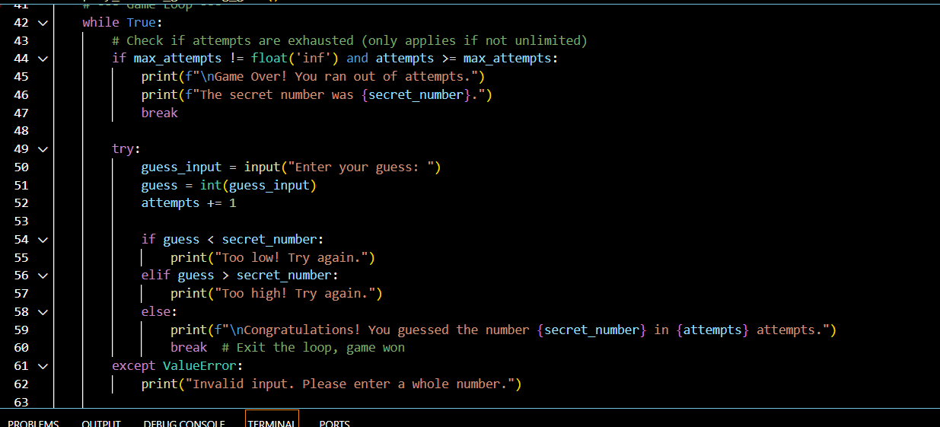

Slide 5
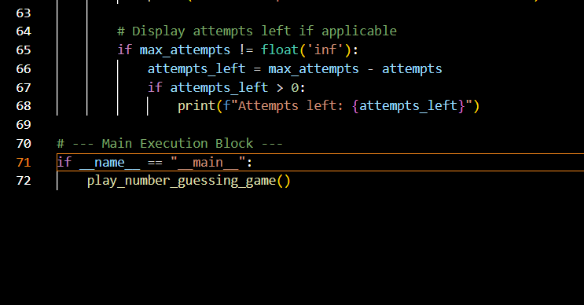

Slide 6
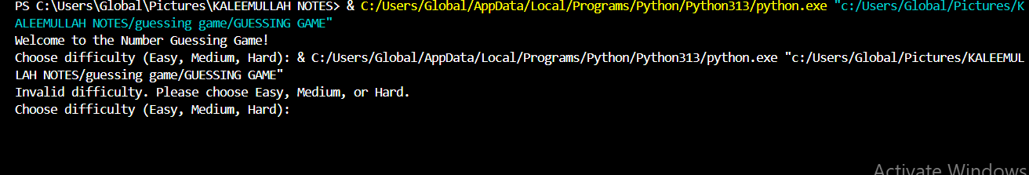

Slide 7
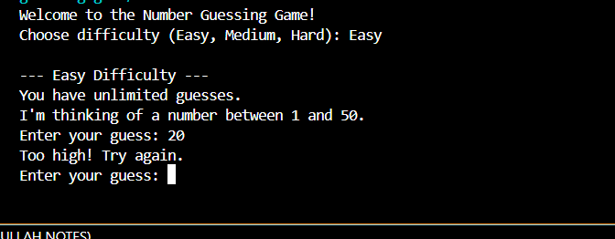

Slide 8
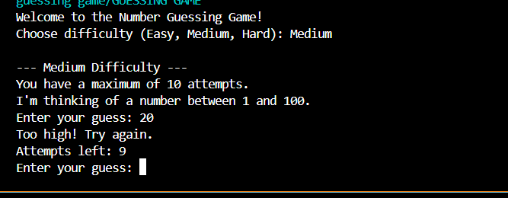

Slide 9
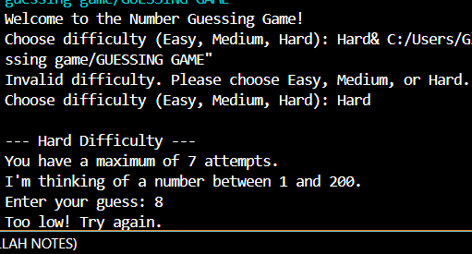

Slide 10
1. Project Title:
Number Guessing Game: An Interactive Console Application with Difficulty Levels
2. Executive Summary:
This document provides a comprehensive overview and detailed documentation for the "Number Guessing Game." The game allows users to guess a randomly generated number within a customizable range, offering immediate feedback to guide their attempts. This project showcases fundamental programming concepts such as random number generation, iterative loops, conditional statements, user input handling, and basic error management. It also includes extensions for adjustable difficulty levels and a limited number of guesses, enhancing its functionality and educational value.

Slide 11
3. Introduction:
The Number Guessing Game is a foundational programming exercise that serves as an excellent tool for understanding core programming principles through interactive application development. This document aims to provide all necessary information, from the source code to its functional breakdown and instructions for execution, making it a complete resource for understanding and running the game.

Slide 12
4. Game Features:
The implemented Number Guessing Game includes the following features:
• Random Number Generation: Generates a secret number within a specified range.
• User Input: Prompts the user to enter their guesses.
• Feedback Mechanism: Provides "Too high!", "Too low!", or "Congratulations!" feedback after each guess.
• Difficulty Levels: Allows the user to select from "Easy," "Medium," or "Hard" difficulties, which adjust the number range and the maximum number of attempts.
• Limited Guesses: For "Medium" and "Hard" difficulties, the game limits the number of attempts the user has.
• Attempt Counter: Tracks and displays the total number of guesses taken.
• Input Validation: Handles non-numeric input gracefully, preventing program crashes.
• Game Over Condition: Ends the game if the user runs out of attempts, revealing the secret number.

Slide 13
5. Technical Requirements:
The game is implemented in Python and requires a standard Python interpreter (version 3.6 or higher recommended) to run. No external libraries beyond Python's standard distribution (random module) are needed.
6. How to Run the Code:
To execute the Number Guessing Game:
1. Save the Code: Copy the entire Python code from Section 7 below.
2. Create a File: Paste the copied code into a new plain text file.
3. Name the File: Save the file with a .py extension (e.g., number_guessing_game.py).
4. Open Terminal/Command Prompt: Navigate to the directory where you saved the file using your command-line interface.
5. Execute: Run the script using the Python interpreter:
Bash
python number_guessing_game.py
The game will then start, prompting you to choose a difficulty level.

